Slide 1
SMART HOME SECURITY AND AUTOMATION SYSTEM USING IOT
DEEPIKA BALAKRISHNAN C
MES20MCA-2015
PRODUCT OWNER-Dr. GEEVER C ZACHARIYAS

Slide 2
TABLE OF CONTENTS
Title of the project
Table of contents
Introduction about your project
Modules
Project plan
User story
Project backlog
Sprint plan
Sprint actual

Slide 3
INTRODUCTION
Home automation is gaining popularity nowadays. Today, we are entering post-PC era where mobile devices are handling daily tasks that traditional desktop and laptop computers once handled. Several reports show that personal computers are no longer on the leading the edge of computing and the use of mobile devices are quickly taking over. A smart home automation system is based on controlling light and fan and making user life easier.
The project mainly consists of three parts, Android Application, Controlling Electrical devices, and Security module. The Android Application enables the user to Search for nearby Bluetooth devices; connect to one of them, then send some data to the connected device through USART serial interface.

Slide 4
In this paper, a solution to transform a normal house to a smart house while reducing the energy consumption is proposed. This can be realized with the help of wireless sensor networks.
The Android phone is integrated into the system which allows the control of the light and fan in the house. The protocol model is developed to demonstrate the effective utilizations of Android phone in home automation.

Slide 5
MODULES
MODULE 1:- USERS
Login
User registration
Change password
Familiar person management
View visitor log
Device control
Receive Notification
MODULE 2:- DESKTOP APPLICATION (CAMERA MODE)
Surveillance
Visitor log entry

Slide 6
Face recognition
MODULE 3:- EMBEDDED
Device control based on user instruction

Slide 7
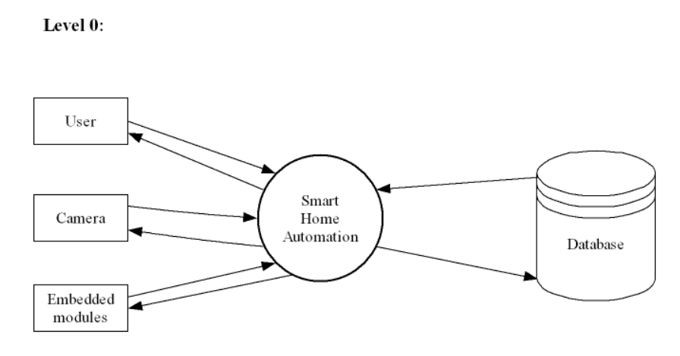
DATA FLOW DIAGRAM

Slide 8
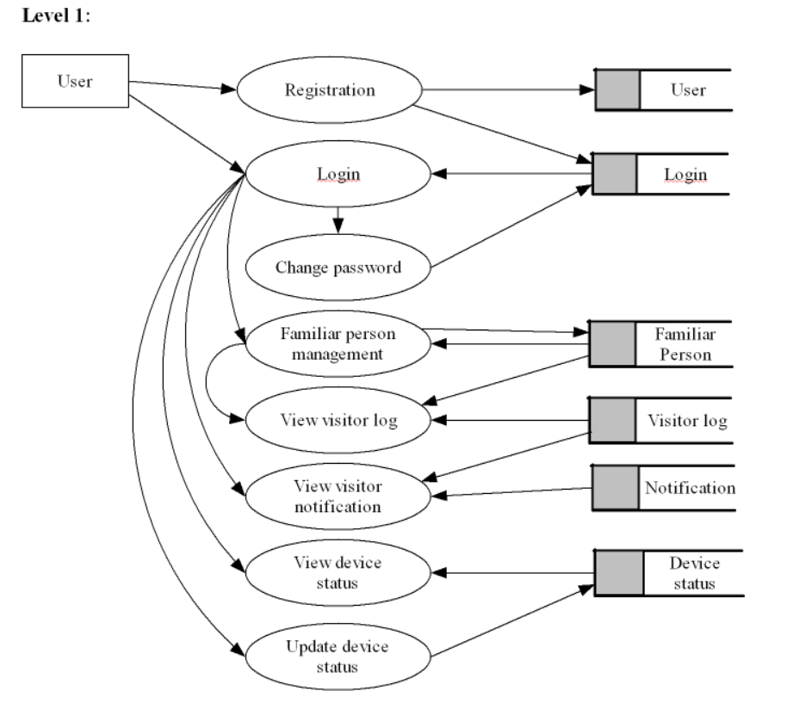

Slide 9
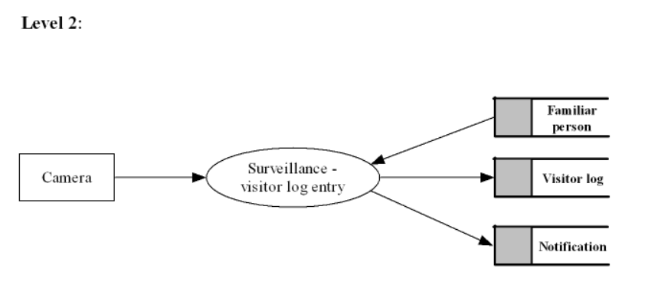

Slide 10
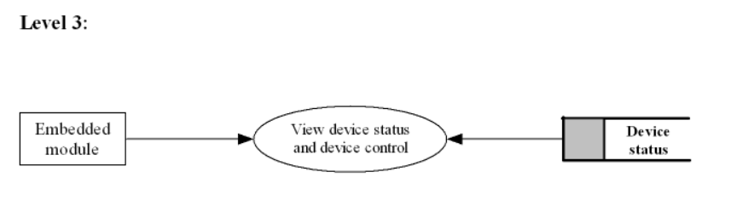

Slide 11
EMBEDDED SYSTEM
Embedded systems consist of a microcontroller with on-board memory, a power supply, and communication ports for transmitting data to other devices. Embedded software programs tell the microcontroller how to respond in real time to data collected from the environment through peripheral sensors and devices.
Embedded systems are used to enhance safety, reduce costs, and offer convenience and cost-savings to customers in industries that include automotive, home/consumer electronics, communications, and healthcare.

Slide 12
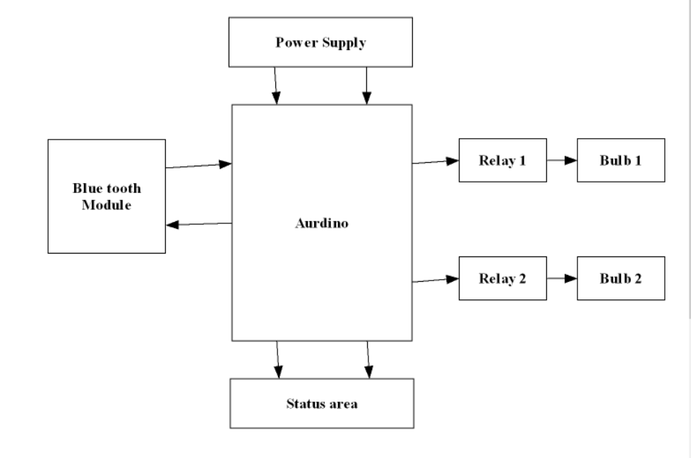
BLOCK DIAGRAM

Slide 13
STEPS OF BLOCK DIAGRAM
In this diagram we have a Power supply, Status area, Arduino, Bluetooth module, 2 relays and 2 bulbs. For the power supply the Arduino, Bluetooth module and relay need 5 volt.12 volt is required to cover the whole project. The Power supply section of the circuit allows to convert the 12 volt adapter into 5 volt Here we are using DC adapter, if we are using AC adapter it convert it into DC adapter having 5 volt. The status area section contains two LED’s: status LED and data LED. When a program loop inside the Arduino, the status LED is used to switch the LED to on and off at the starting of a program, it repeats depending on the program.it allow us to understand our program is running well. Status LED is in green color. Data LED is in blue color, this blue color indicates if there is any data transaction is taken place through the Bluetooth module, the LED starts to on and off. Relay is a switching device. The 230 volt power supply is not directly sent to bulb, it is done through passing it across the relay and then to bulb. In order to do that we need to make the relay short we need to apply 5 volt power into the relay from Arduino, then only the power is supplied to bulb, other time it is open. When an app start there is a button

Slide 14
to connect the Bluetooth module device. When we click the button it list all the nearby devices that are on, in that list our Bluetooth device will also come if its power is on, then just click the device to connect it. When it is connected, through the Bluetooth device we can sent any data or character from the Arduino broad and it is received through the app. This is the way the app and Arduino is communicated. If we give a command to on the bulb in app, it receives from Bluetooth through Arduino board. Arduino board process it and look the letter if it is A one bulb is on, B next bulb is on, C one bulb is off, D next bulb is off. We also sent the status of the bulb through Arduino to Bluetooth

Slide 15
TABLE DESIGN
1. Login:
Field Name | Datatype | Constraints
L id | Int | Primary Key
Username | Varchar (50) | Not Null
Password | Varchar (50) | Not Null

Slide 16
2. Familiar:
3. Device control:
Field Name | Datatype | Constraints
F id | Int | Primary Key
Name | Varchar (50) | Not Null
Photo | Varchar (50) | Not Null
Description | Varchar (50) | Not Null
Field Name | Datatype | Constraints
Device id | Int | Primary Key
Status | Varchar (50) | Not Null

Slide 17
4. Visitor log:
5. Notification:
Field Name | Datatype | Constraints
Vlog id | Int | Primary Key
Date | Date | Not Null
Time | Time | Not Null
Visitor Name | Varchar (50) | Not Null
Photo | Varchar (50) | Not Null
Field Name | Datatype | Constraints
N id | Int | Primary Key
Vlog id | Int | Foreign Key
Date | Date | Not Null
Status | Varchar (50) | Not Null

Slide 18
6. User registration:
Field Name | Datatype | Constraints
Uid | Int | Primary Key
Uname | Varchar (50) | Not Null
Place | Varchar (50) | Not Null
District | Varchar (50) | Not Null
Email | Varchar (50) | Not Null
Image | Varchar (50) | Not Null
Phone | Bigint | Not Null
L id | int | Foreign Key

Slide 19
DEVELOPING ENVIRONMENT
Hardware Requirements
Input Device : Mouse, Keyboard
Output Device : Monitor
Memory : 4 Gb Ram (Minimum)
Processor : Intel core i3 or above
Software Requirements
Operating System : Windows 8 /10for Better Performance , Android
Front End : Android
Back End : MySQL
Software Used : PyCharm , Android Studio , SQLyog

Slide 20
PRODUCT BACKLOG
User story ID | Priority <High/Medium/Low> | Size (Hours) | Sprint <#> | Status <Planned/In progress/Completed> | Release Date | Release Goal
1 | Medium | 6 | 1 | Completed | 1/12/2021 | Form designing and table designing
2 | High | 8 |  | Completed | 15/12/2021 | Coding
3 | Medium | 5 | 2 | Completed | 26/12/2021 | Form designing
4 | High | 5 |  | Completed | 1/01/2022 | Coding
5 | Medium | 8 | 3 | Completed | 15/01/2022 | Form designing
6 | High | 8 |  | Completed | 28/01/2022 | Coding, Face recognition (familiar person detection)
7 | Medium | 5 | 4 | Completed | 4/02/2022 | Embedded, Configuration
8 | High | 5 |  | Completed | 10/02/2022 | Configuration testing, Implementation

Slide 21
USER STORY
User Story ID | As a type of User | I want to < perform some task > | So that I can < Achieve Some Goal >
1 | User | Sign Up | I can save my details required for login
2 | User | Login | I can get access to the system
3 | User | Chang password | I can change my login credential
4 | User | Add familiar person | Can add familiar person for face recognition
5 | User | View familiar person | Can view the familiar person
6 | User | Edit familiar person | Can edit the familiar person details
7 | User | Delete familiar person | Can remove familiar person
8 | Camera | Camera surveillance | Can identify visitors and familiar persons using face recognition

Slide 22
9 | User | View Visitor logs | Can view Visitor logs entered by camera module
8 | User | View device status | Can view device status
9 | User | Update device status | Can update device status
10 | Embedded Module | Update device status | Can update device status according to the instructions obtained

Slide 23
PROJECT PLAN
User Story ID | Task Name | Start Date | End Date | Days | Status
1 | Sprint 1 | 01/12/2021 | 17/11/2021 | 2 | Completed
2 |  | 08/12/2021 | 22/11/2021 | 3 | Completed
3 |  | 15/12/2021 | 08/12/2021 | 5 | Completed
4
5
6
7
8
9

Slide 24
SPRINT BACKLOG PLAN
Backlog Items | Status and Completion date | Original estimate in hours |  | Day1 2/3 | Day2 3/3 | Day1 4/3 | Day1 5/3 | Day1 6/3 | Day1 7/3 | Day1 8/3 | Day1 9/3 | Day1 10/3 | Day1 11/3 | Day1 12/3 | Day1 13/3 | Day1 14/3 | Day1 15/3
User story #1,2,3,4 |  | hrs |  | hrs | hrs | hrs | hrs | hrs | hrs | hrs | hrs | hrs | hrs | hrs | hrs | hrs | hrs
UI designing | 10/12/2021 | 3 |  | 0 | 0 | 0 | 2 | 1 | 0 | 0 | 0 | 0 | 0 | 0 | 0 | 0 | 0
Database connectivity | 12/12/2021 | 2 |  | 0 | 1 | 0 | 1 | 0 | 0 | 0 | 0 | 0 | 0 | 0 | 0 | 0 | 0
Coding | 17/12/2021 | 4 |  | 1 | 0 | 2 | 1 | 0 | 0 | 0 | 0 | 0 | 0 | 0 | 0 | 0 | 0
Testing | 21/12/2021 | 1 |  | 1 | 0 | 0 | 0 | 0 | 0 | 0 | 0 | 0 | 0 | 0 | 0 | 0 | 0
User story #5,6,7,9,10
UI designing | 24/12/2021 | 24/12/2021 | 2 | 0 | 0 | 0 | 0 | 0 | 0 | 0 | 1 | 1 | 0 | 0 | 0 | 0 | 0
Database connectivity | 26/12/2021 | 26/12/2021 | 2 | 0 | 0 | 0 | 1 | 1 | 0 | 0 | 0 | 0 | 0 | 0 | 0 | 0 | 0
Coding | 26/12/2021 | 26/12/2021 | 4 | 1 | 0 | 2 | 0 | 1 | 0 | 0 | 0 | 0 | 0 | 0 | 0 | 0 | 0
Testing | 31/12/2021 | 31/12/2021 | 1 | 0 | 0 | 0 | 0 | 0 | 0 | 0 | 0 | 0 | 0 | 0 | 0 | 0 | 0

Slide 25
User story #8,12 | Status and Completion date | Original estimate in hours | Day1 2/3 | Day2 3/3 | Day3 4/3 | Day4 5/3 | Day5 6/3 | Day6 7/3 | Day7 8/3 | Day8 9/3 | Day9 10/3 | Day10 11/3 | Day11 12/3 | Day12 13/3 | Day13 14/3 | Day14 15/3
UI designing | 15/1/2022 | 3 | 1 | 0 | 1 | 0 | 1 | 0 | 0 | 0 | 0 | 0 | 0 | 0 | 0 | 0
Database connectivity | 16/1/2022 | 2 | 1 | 1 | 0 | 0 | 0 | 0 | 0 | 0 | 0 | 0 | 0 | 0 | 0 | 0
Coding | 20/1/2022 | 5 | 2 | 1 | 0 | 0 | 2 | 0 | 0 | 0 | 0 | 0 | 0 | 0 | 0 | 0
Testing | 29/1/2022 | 1 | 1 | 0 | 0 | 0 | 0 | 0 | 0 | 0 | 0 | 0 | 0 | 0 | 0 | 0
User story #13,14,15,16,17
UI designing | 6/2/2022 | 5 | 1 | 2 | 0 | 0 | 1 | 1 | 0 | 0 | 0 | 0 | 0 | 0 | 0 | 0
Database connectivity | 8/2/2022 | 5 | 2 | 0 | 0 | 1 | 1 | 0 | 0 | 0 | 0 | 0 | 0 | 0 | 0 | 0
Coding | 10/2/2022 | 8 | 2 | 1 | 1 | 0 | 0 | 2 | 1 | 1 | 0 | 0 | 0 | 0 | 0 | 0
Testing | 15/2/2022 | 2 | 1 | 1 | 0 | 0 | 0 | 0 | 0 | 0 | 0 | 0 | 0 | 0 | 0 | 0

Slide 26
SPRINT BACKLOG ACTUAL
Backlog Items | Status and Completion date | Original estimate in hours | Day1 2/3 | Day2 3/3 | Day1 4/3 | Day1 5/3 | Day1 6/3 | Day1 7/3 | Day1 8/3 | Day1 9/3 | Day1 11/3 | Day1 12/3 | Day1 13/3 | Day1 14/3 | Day1 15/3 | Completed <Y/N>
User story #1,2,3,4 |  | Hrs | Hrs | Hrs | Hrs | Hrs | Hrs | Hrs | Hrs | Hrs | Hrs | Hrs | Hrs | Hrs | Hrs | YES
UI designing | 10/12/2021 | 3 | 0 | 0 | 0 | 2 | 1 | 0 | 0 | 0 | 0 | 0 | 0 | 0 | 0 | YES
Database connectivity | 12/12/2021 | 2 | 0 | 1 | 0 | 1 | 0 | 0 | 0 | 0 | 0 | 0 | 0 | 0 | 0 | YES
Coding | 17/12/2021 | 4 | 1 | 0 | 2 | 1 | 0 | 0 | 0 | 0 | 0 | 0 | 0 | 0 | 0 | YES
Testing | 21/12/2021 | 1 | 1 | 0 | 0 | 0 | 0 | 0 | 0 | 0 | 0 | 0 | 0 | 0 | 0 | YES
Total |  | 10 | 2 | 1 | 2 | 4 | 1 | 0 | 0 | 0 | 0 | 0 | 0 | 0 | 0

